Slide 1
From Barcelona to San Sebastian
1.Arrival the airport
2. Barcelona–El Prat Airport to Sants
https://goo.gl/maps/dZRdDDmDtrp
Subway R2N: Aeroport to Barcelona Sants
3.Renfe 西班牙高铁
BARCELONA-SANTS to San Sebastian/Donostia
https://venta.renfe.com/vol/search.do?c=_vvoJ
出发时间 | 到达时间 | 用时 | 火车 | 最低售价 | 舱位 | 税
7:30 | 13.03 | 5 h. 33 min. | ALVIA | 38,80 € | Turista | Promo
10:05 | 15.48 | 5 h. 43 min. | INTERCITY | 37,15 € | Turista | Promo
15:30 | 21.1 | 5 h. 40 min. | ALVIA | 38,80 € | Turista | Promo

Slide 2
San Sebastián
San Sebastián (Spanish: [san seβasˈtjan]) or Donostia (Basque: [doˈnos̺tia])^{[3]} is a coastal city and municipality located in the Basque Autonomous Community(巴斯克自治区) , Spain. It lies on the coast of the Bay of Biscay(比斯开湾), 20 km (12 miles) from the French border. The capital city of Gipuzkoa, the municipality's population is 186,095 as of 2015,^{[4]} with its metropolitan area reaching 436,500 in 2010.^{[5]} Locals call themselves donostiarra(singular), both in Spanish^{[6]} and Basque.
The main economic activities are commerce and tourism, and it is one of the most famous tourist destinations in Spain.^{[7]} Despite the city’s small size, events such as the San Sebastián International Film Festival have given it an international dimension. San Sebastián, along with Wrocław, Poland, was the European Capital of Culture in 2016.^{[8]}
插座转换器，自带插线板，电饭锅，电水壶，网线。
手机卡：orange

Slide 3
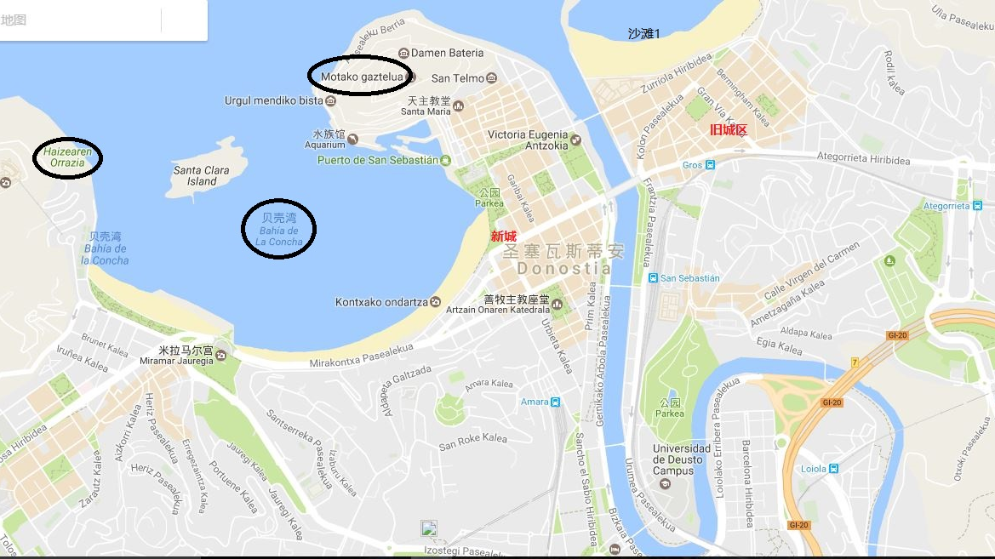
San Sebastian

Slide 4
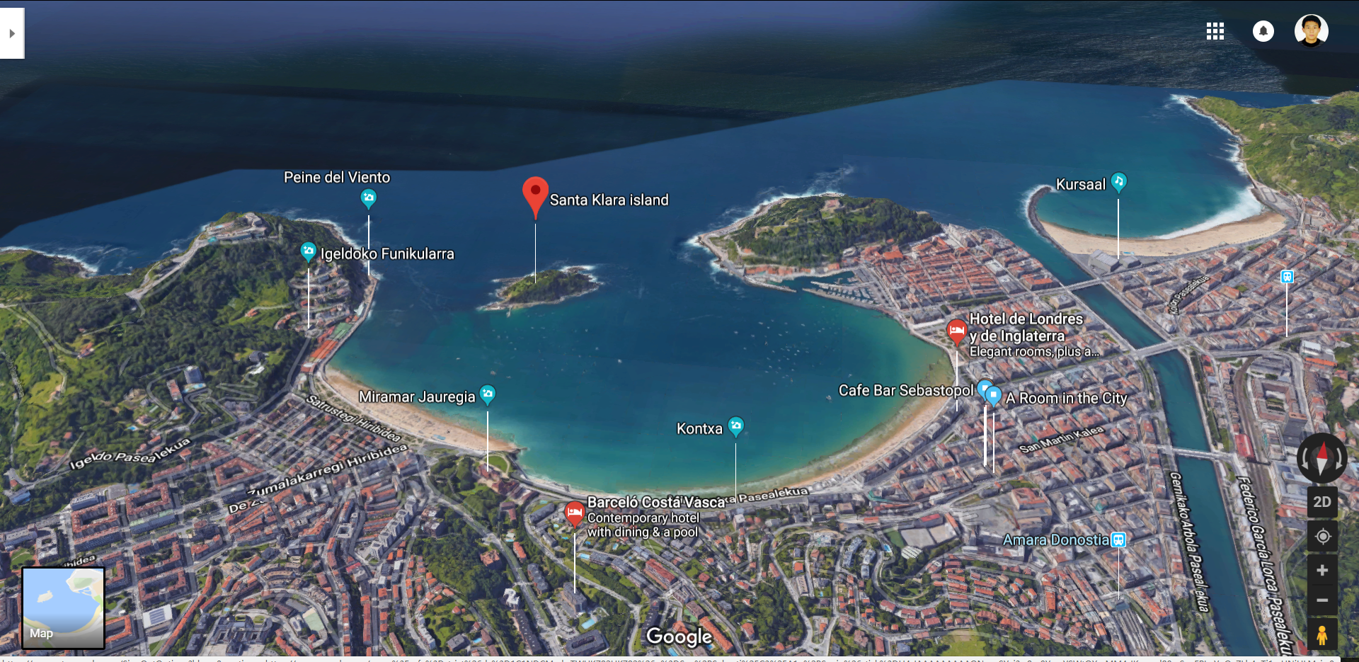
景点
The beach of La Concha 贝壳海滩
https://www.spain-holiday.com/San-Sebastian/articles/the-beach-of-la-concha-in-san-sebastian-a-beach-you-must-see
http://www.mafengwo.cn/i/7136786.html

Slide 5
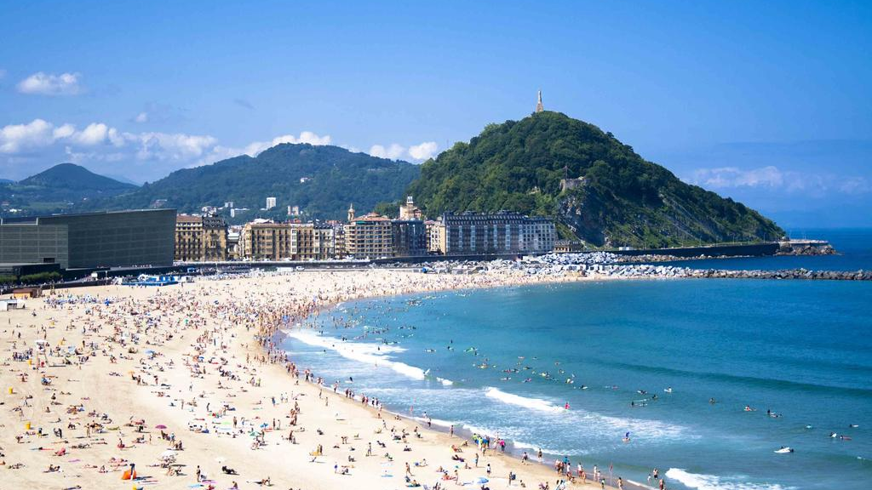
Zurriola hondartza
Watching Sunset
Near old town
Big spindrift
Most northern
Notes:
先说最北边的沙滩，这个是最壮观的，因为中间没有小岛阻挡潮水，因此这里的浪潮最汹涌，沙滩边缘都有石块围起来，据说涨潮的时候都会淹没。这里可以看日落，因为没有小岛挡住视线，这里也更靠近老城区。我生日那天，一个人来海边看日落，夕阳照在沙滩上，金黄金黄的色调，暖心得很。本想等着太阳下山，但是和实验室的小伙伴约了晚饭，当太阳还在海平面上的时候我就闪人了。

Slide 6
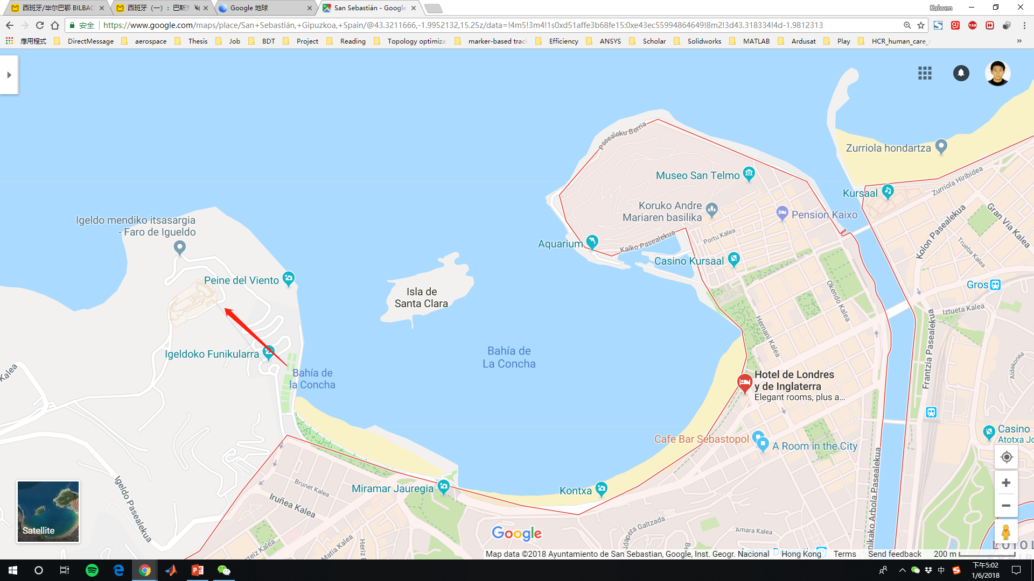
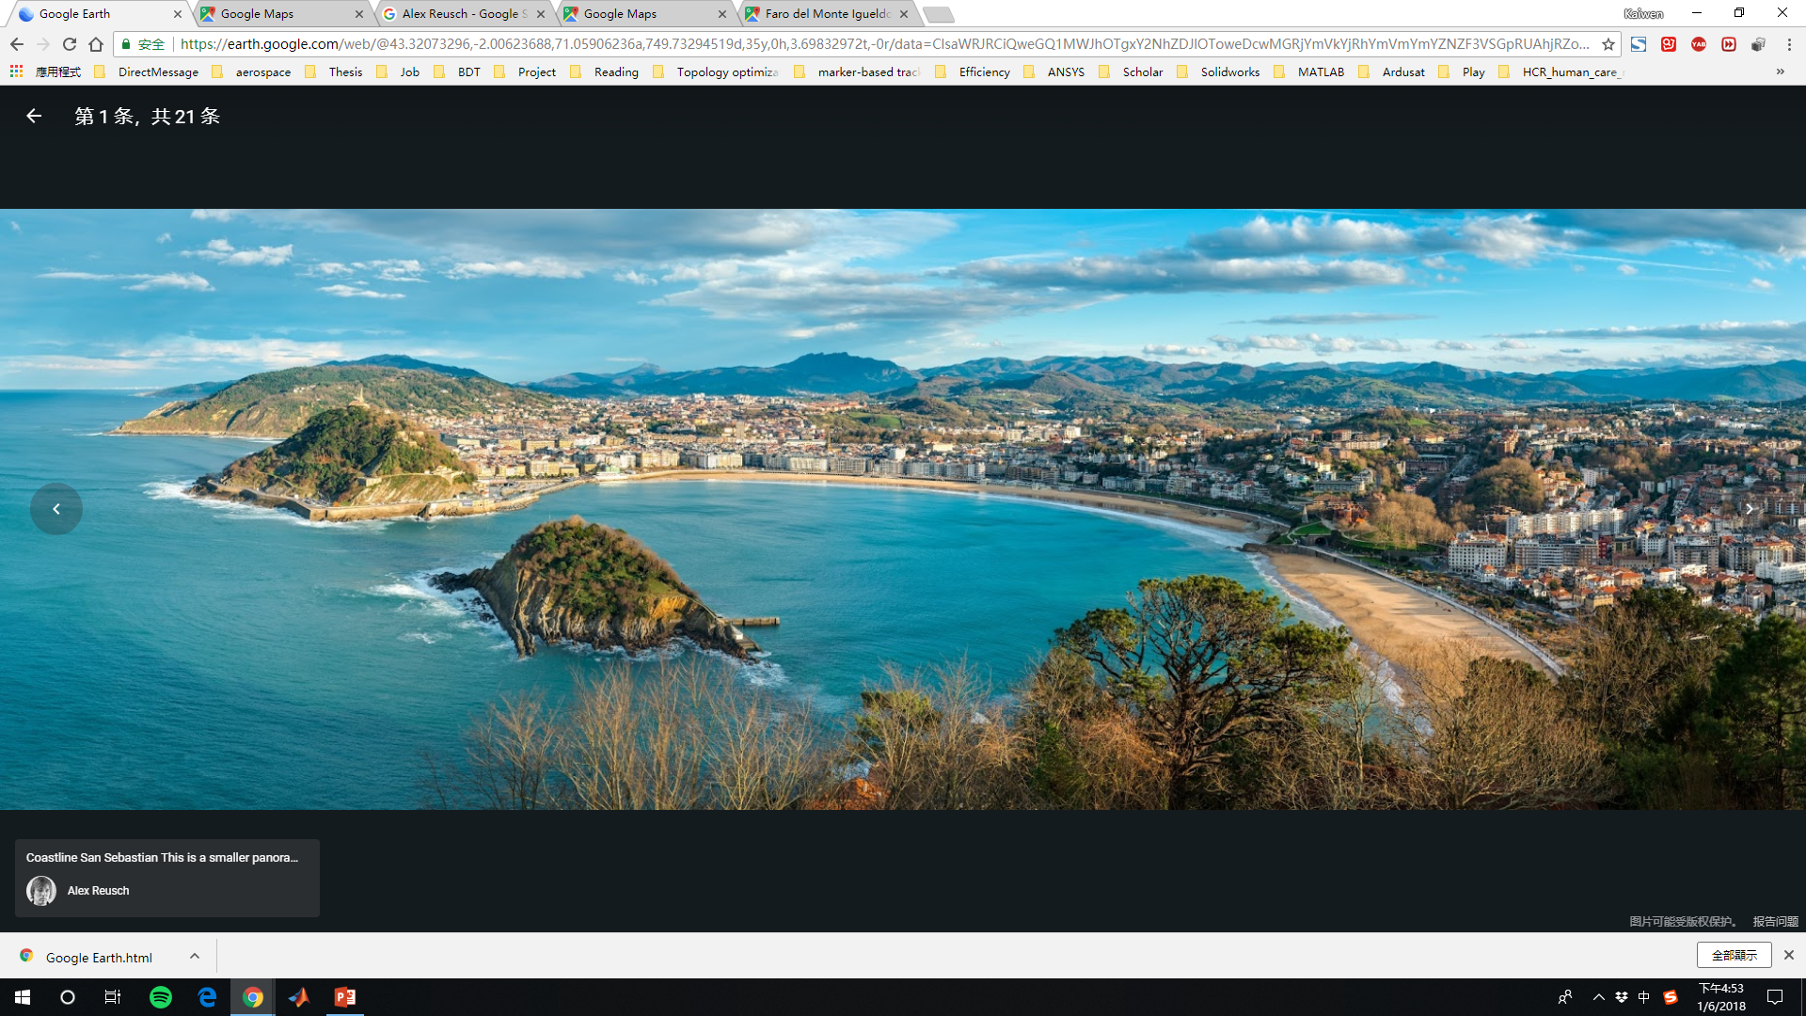
Top highest place in the beach of La Concha
Itsasargi
Parque de Atracciones Monte Igueldo
Hotel Mercure San Sebastian Monte Igueldo
Notes:
做小火车上山，门票3.25欧，上面是一个游乐场，可以看日落。

Slide 7
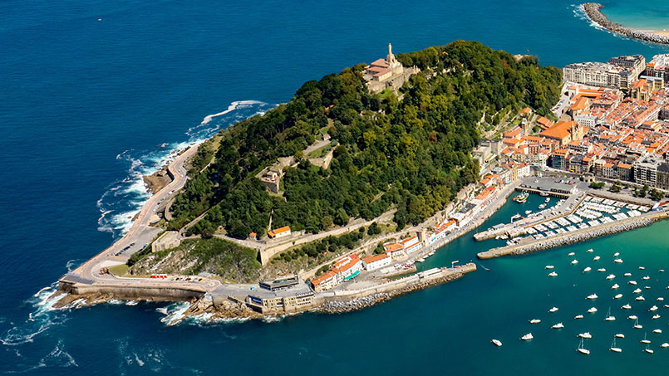
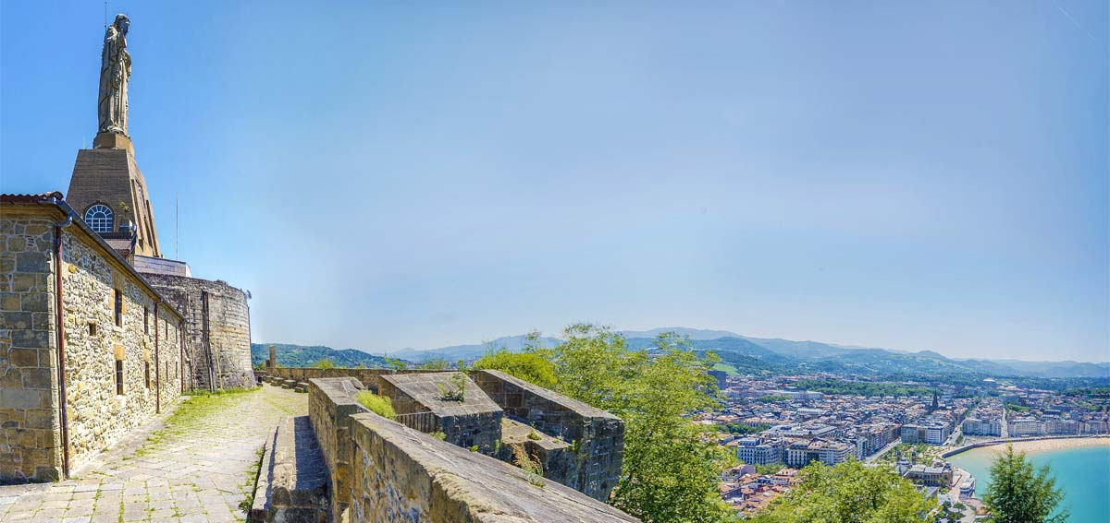
乌尔古尔山（Monte Urgull）
https://www.sansebastianturismo.com/en/to-do/what-not-to-miss/mount-urgull
Notes:
You can walk to the summit of Monte Urgull, topped by the low castle walls of the Castillo de la Mota and a grand statue of Christ, by taking a path from Plaza de Zuloaga or from behind the aquarium. The views are breathtaking and the shady parkland on the way up is a peaceful retreat from the city.

Slide 8
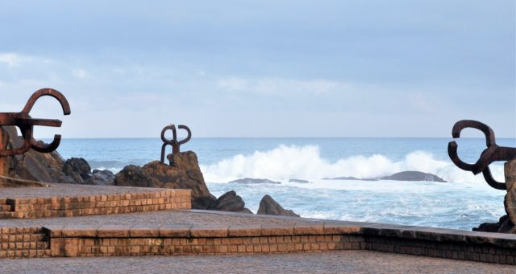
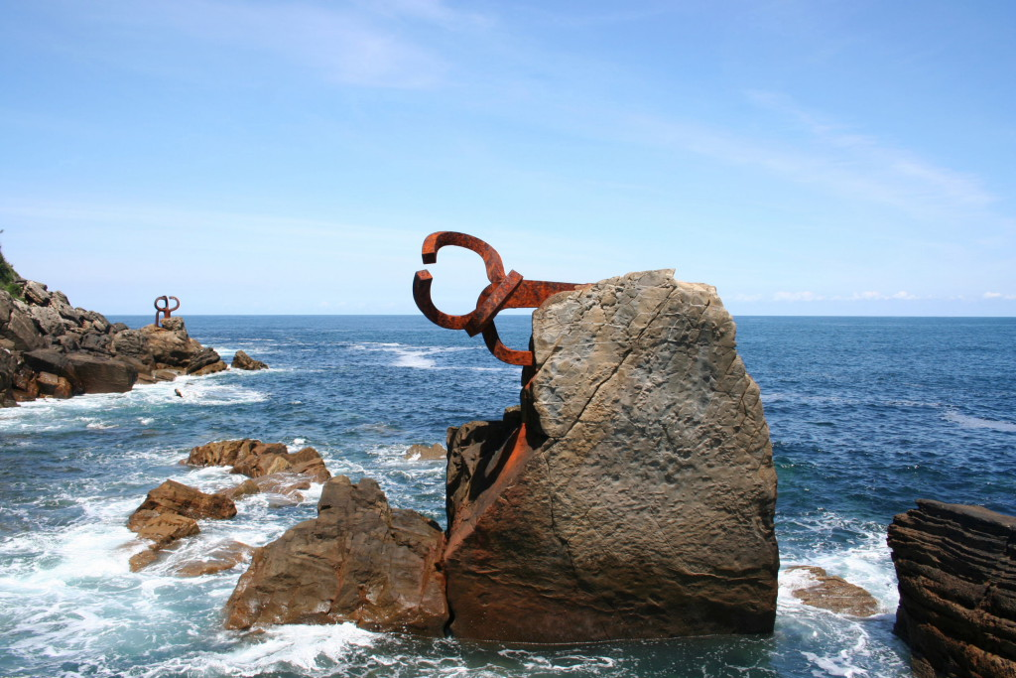
Peine Del Viento 风之梳
钢铁雕塑《风之梳》是西班牙雕塑家爱德华多·奇利达（1924～2002）于1977年完工的室外雕塑作品。他用条形锻铁作为创作用材组合成三个钢铁雕塑，一个垂直竖立在近海的巨石上，两个呈水平状态插入海岸的峭壁中。雕塑组合的变化代表着生命运动，显示了敢与大风大浪搏击的勇气与倔强性格，被誉为当代经典作品. https://vacation.eztravel.com.tw/sight/plc0000070812/haizearen-orrazia-%E9%A2%A8%E4%B9%8B%E6%A2%B3

Slide 9
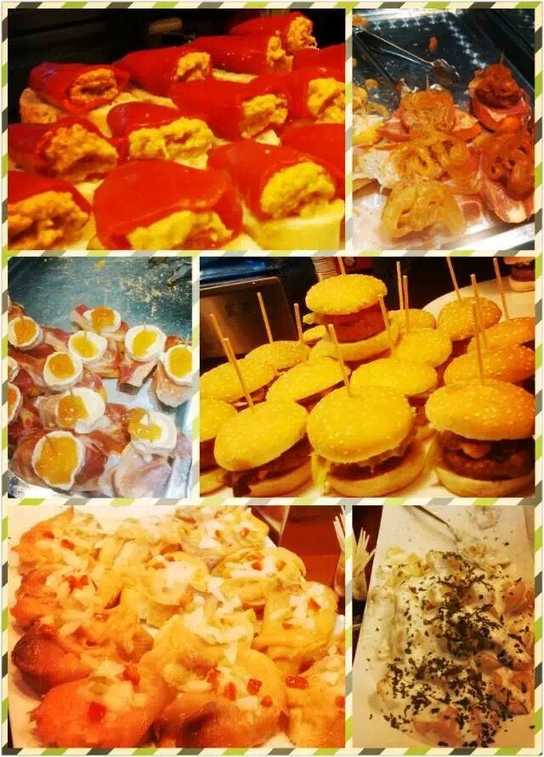
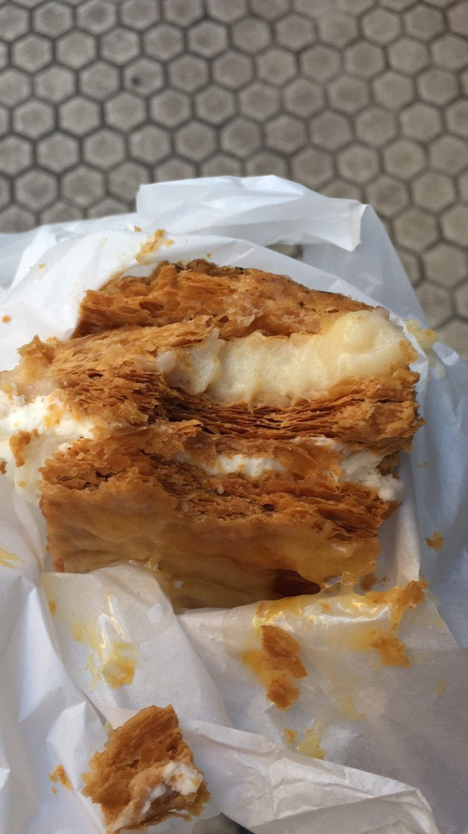
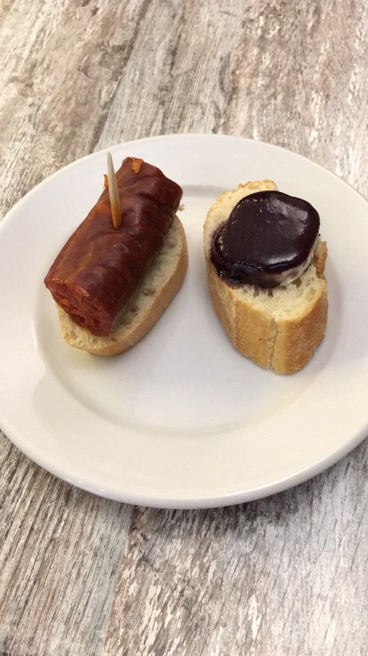
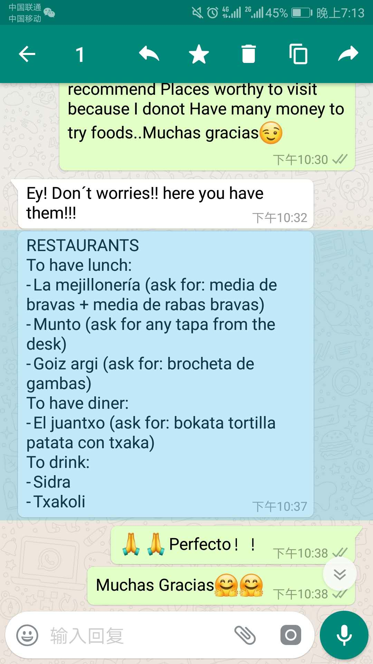
Snacks in 圣塞
Delicia
Pinchos
Pintxo(A cup of wine + a snack)(discount at Thursday)
Notes:
Delicia 1.95欧
Pinchos 1-2欧

Slide 10
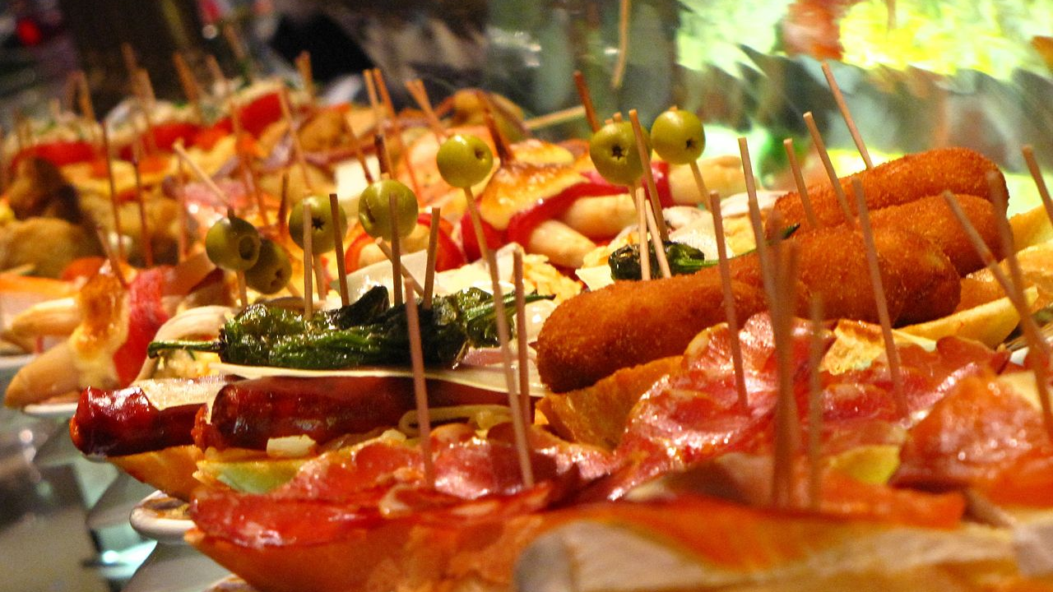
Tapas
Food Kind, Tapa or Tapas: appetizer(before lunch/dinner) or snack in Spanish cuisine
Cold such as mixed with olives and cheese
Hot such as chopitos which are battered, fried baby squid
Tapas variant: bocas(in Central American countries) or botanas(in Mexico)

Slide 11
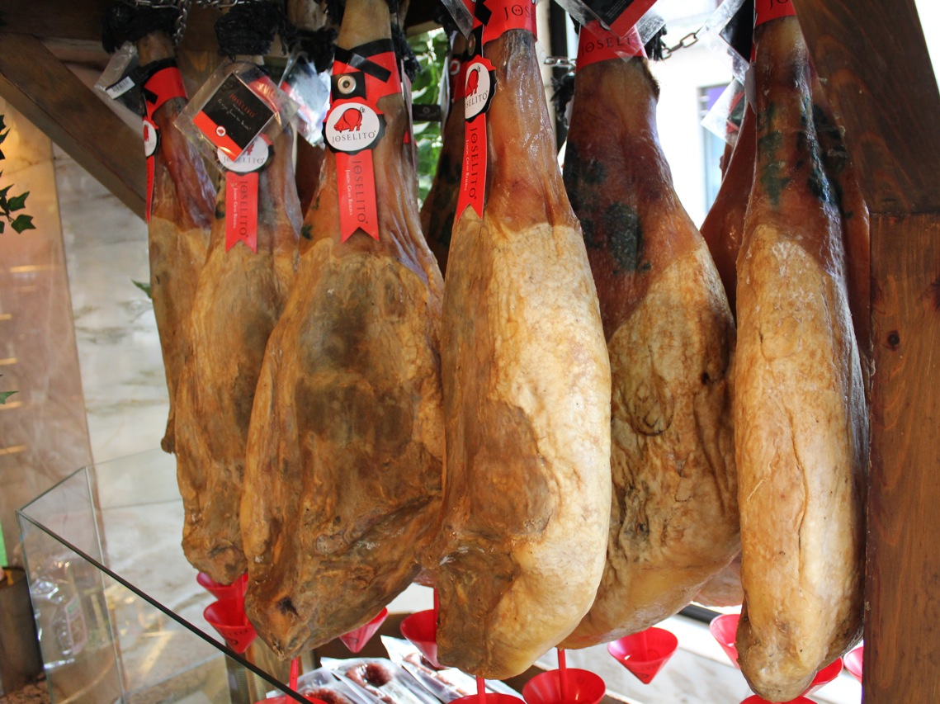
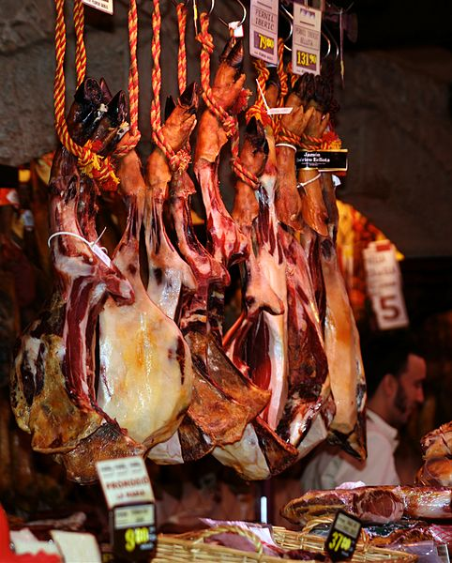
Jamon
Spanish word for ham. Dry-cured ham
1.Eat with Hami melon哈密瓜
2.Two types: Jamon iberico/ jamon serrano

Slide 12
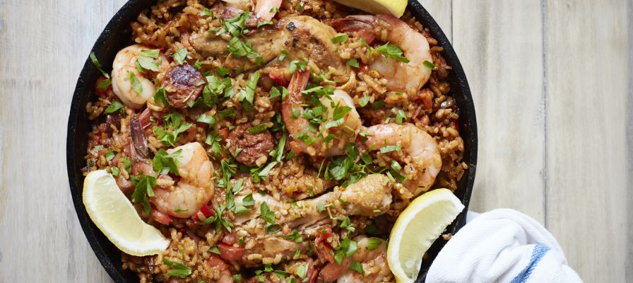
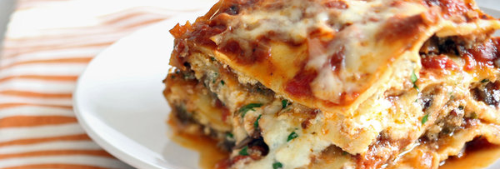
1.Spanish seafood Paella: Valencian rice dish, rice + soup + wine + indigents(rabbit, chicken, red gold-saffron), Paella is a kind of wok
2.Lasagna: wide, flat pasta, and possibly one of the oldest types of pasta. a dish made with several layers of lasagna sheets alternated with sauces and other ingredients, such as meats and cheese.
Notes:
Western food condiment: Basil, Rosemary, Passion fruit, coriander(芫荽/香菜), citrus fruit, artichoke(洋蓟), saffron, red pepper
Dancing bar
Discoteca: place for dancing, nightclub

Slide 13
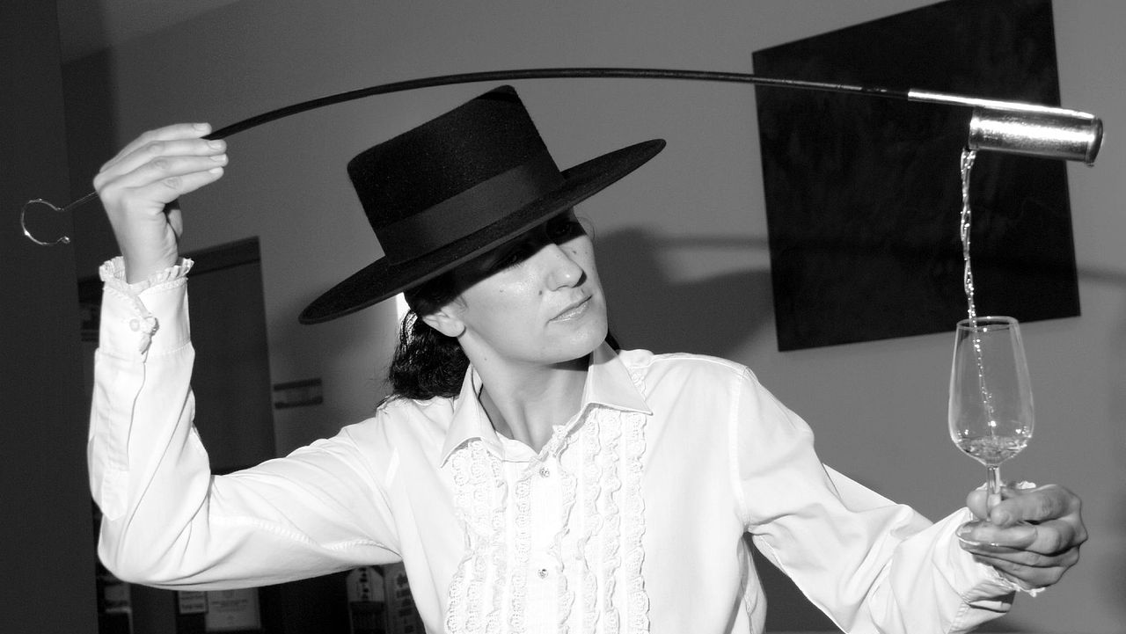
酒 Wine
Sherry
a fortified wine made from white grapes that are grown near the city of Jerez de la Frontera in Andalusia, Spain.
Venenciar: A venenciadora pours Sherry drawn from a cask (or "Venencia") into a catavino
Notes:
to pour sherry using a venencia

Slide 14
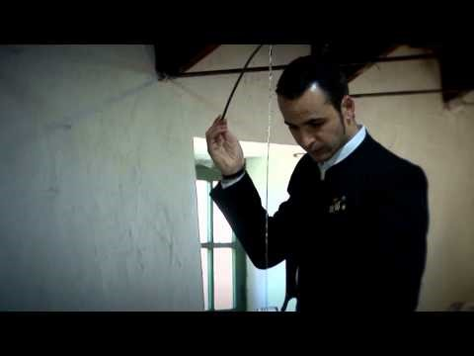
Jose Manuel Ruz Venenciador

Slide 15
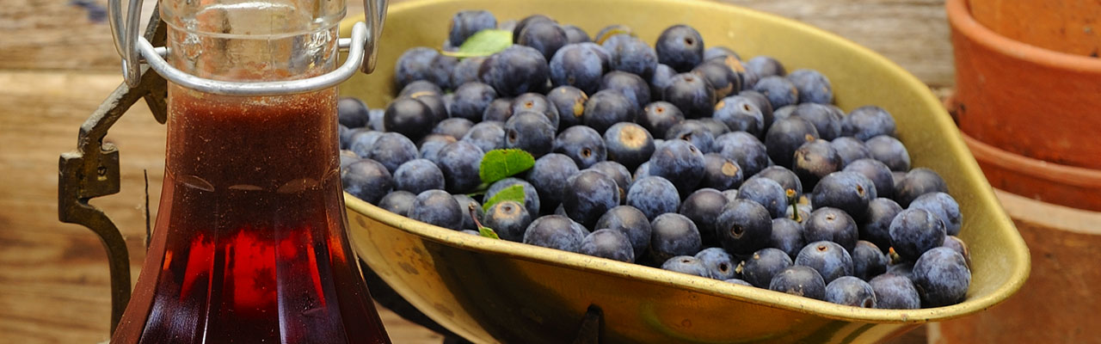
Wine 酒
1.jerez
2.Crianza/Reserva/Gran Reserva + Rioja/ Ribera de Duero
3.Orujo
4.Cava from Barcelona
5.Anis
6.Cider from Asturies
7.Patxaran from Navarra
8.Rum from Andalucía

Slide 16
Brand 品牌
ZARA
Mangle

Slide 17
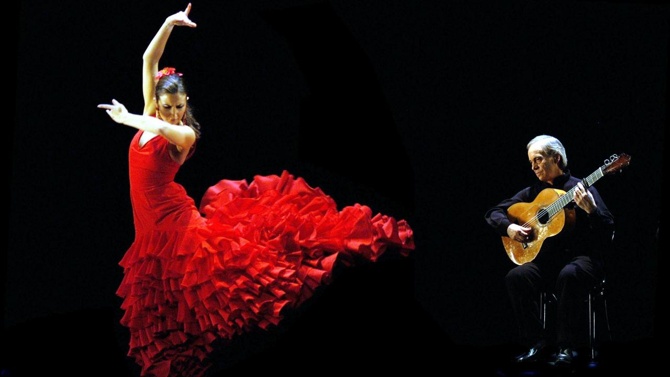
Flamenco
from Arabic:felagmengu meaning fugitive peasant
The musical traditions fused from Moors, Jews and gypsies in down-at-heel parts of town like Triana in Seville
Moors brought the guitar to Spain, Dramatic arm and hand movements, similar to Moorish dancing
Sing style is similar to wailing Arabic style
Singing and dancing in the bar
The music of the dispossessed

Slide 18
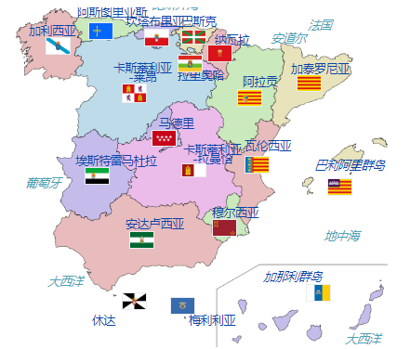
名称 （西语原名） | 首府 | 省份 | 省治
安达卢西亚自治区 Andalucía | 塞维利亚 Sevilla | 阿尔梅里亚省 Almería | 阿尔梅里亚 Almería
 |  | 加的斯省 Cádiz | 加的斯 Cádiz
 |  | 科尔多瓦省 Córdoba | 科尔多瓦 Córdoba
 |  | 格拉纳达省 Granada | 格拉纳达 Granada
 |  | 韦尔瓦省 Huelva | 韦尔瓦 Huelva
 |  | 哈恩省 Jaén | 哈恩 Jaén
 |  | 马拉加省 Málaga | 马拉加 Málaga
 |  | 塞维利亚省 Sevilla | 塞维利亚 Sevilla
阿拉贡自治区 Aragón | 萨拉戈萨 Zaragoza | 韦斯卡省 Huesca | 韦斯卡 Huesca
 |  | 特鲁埃尔省 Teruel | 特鲁埃尔 Teruel
 |  | 萨拉戈萨省 Zaragoza | 萨拉戈萨 Zaragoza
阿斯图里亚斯 ast：Asturies spa：Asturias | 奥维耶多 Oviedo
巴利阿里群岛 spa：Islas Baleares cat：Illes Balears | 帕尔马 Palma de Mallorca
巴斯克自治区 eus：Euskal Autonomi Erkidegoa spa：Comunidad Autónoma del País Vasco | 维多利亚 eus：Gasteiz spa：Vitoria | 阿拉瓦省 eus：Araba spa：Álava | 维多利亚 eus：Gasteiz spa：Vitoria
 |  | 比斯开省 eus：Bizkaia spa：Vizcaya | 毕尔包 eus：Bilbo spa：Bilbao
 |  | 基普斯夸省 eus：Gipuzkoa spa：Guipúzcoa | 圣塞巴斯提安 eus：Donostia spa：San Sebastián
加那利群岛 Islas Canarias | 拉斯帕尔马斯 Las Palmas 圣克鲁斯-德特内里费 Santa Cruz de Tenerife | 拉斯帕尔马斯省 Las Palmas | 拉斯帕尔马斯 Las Palmas
 |  | 圣克鲁斯-德特内里费省 Santa Cruz de Tenerife | 圣克鲁斯-德特内里费 Santa Cruz de Tenerife
坎塔布里亚 Cantabria | 桑坦德 Santander
卡斯蒂利亚-拉曼恰 Castilla-La Mancha | 托莱多 Toledo 阿尔瓦塞特 Albacete | 阿尔瓦塞特省 Albacete | 阿尔瓦塞特 Albacete
 |  | 雷阿尔城省 Ciudad Real | 雷阿尔城 Ciudad Real
 |  | 昆卡省 Cuenca | 昆卡 Cuenca
 |  | 瓜达拉哈拉省 Guadalajara | 瓜达拉哈拉 Guadalajara
 |  | 托莱多省 Toledo | 托莱多 Toledo
卡斯蒂利亚-莱昂 Castilla y León | 巴利亚多利德 Valladolid 布尔戈斯 Burgos | 阿维拉省 Ávila | 阿维拉 Ávila
 |  | 布尔戈斯省 Burgos | 布尔戈斯 Burgos
 |  | 莱昂省 León | 莱昂 León
 |  | 帕伦西亚省 Palencia | 帕伦西亚 Palencia
 |  | 萨拉曼卡省 Salamanca | 萨拉曼卡 Salamanca
 |  | 塞哥维亚省 Segovia | 塞哥维亚 Segovia
 |  | 索里亚省 Soria | 索里亚 Soria
 |  | 巴利亚多利德省 Valladolid | 巴利亚多利德 Valladolid
 |  | 萨莫拉省 Zamora | 萨莫拉 Zamora
加泰罗尼亚 cat：Catalunya spa：Cataluña | 巴塞罗纳 Barcelona | 巴塞罗纳省 Barcelona | 巴塞罗纳 Barcelona
 |  | 赫罗纳省 cat：Girona spa：Gerona | 赫罗纳 cat：Girona spa：Gerona
 |  | 莱里达省 cat：Lleida spa：Lérida | 莱里达 cat：Lleida spa：Lérida
 |  | 塔拉戈纳省 Tarragona | 塔拉戈纳 Tarragona
埃斯特雷马杜拉 Extremadura | 梅里达 Mérida | 巴达霍斯省 Badajoz | 巴达霍斯 Badajoz
 |  | 卡塞雷斯省 Cáceres | 卡塞雷斯 Cáceres
加利西亚自治区 glg：Galicia, Galiza spa：Galicia | 圣地亚哥德孔波斯特拉 Santiago de Compostela | 拉科鲁尼亚省 glg：A Coruña spa：La Coruña | 拉科鲁尼亚 glg：A Coruña spa：La Coruña
 |  | 卢戈省 Lugo | 卢戈 Lugo
 |  | 奥伦塞省 glg：Ourense spa：Orense | 奥伦塞 glg：Ourense spa：Orense
 |  | 蓬特韦德拉省 Pontevedra | 蓬特韦德拉 Pontevedra
拉里奥哈自治区 La Rioja | 洛格罗尼奥 Logroño
马德里自治区 Madrid | 马德里 Madrid
穆尔西亚自治区 Murcia | 穆尔西亚 Murcia
纳瓦拉 eus：Nafarroako Foru Komunitatea spa：Comunidad Foral de Navarra | 潘普洛纳 eus：Iruña spa：Pamplona
瓦伦西亚自治区 cat-vl：Comunitat Valenciana spa：Comunidad Valenciana | 瓦伦西亚 Valencia | 阿利坎特省 cat-vl：Alacant spa：Alicante | 阿利坎特 cat-vl：Alacant spa：Alicante
 |  | 卡斯特利翁省 cat-vl：Castelló spa：Castellón | 卡斯特利翁-德拉普拉纳 cat：Castelló de la Plana spa：Castellón de la Plana
 |  | 瓦伦西亚省 cat-vl：València spa：Valencia | 瓦伦西亚 cat-vl：València spa：Valencia

Slide 19
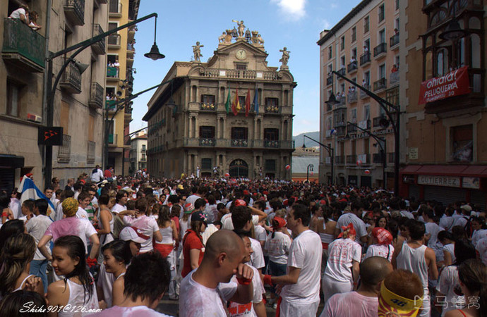
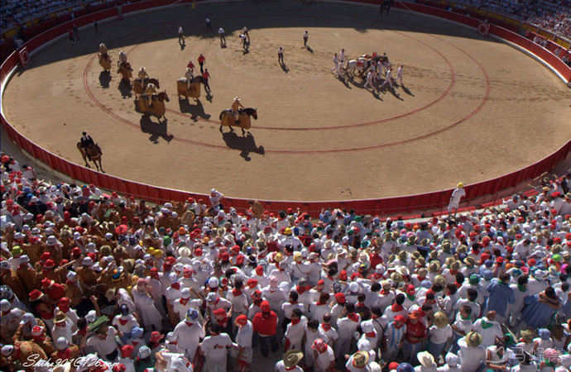
潘普洛纳斗牛场 Pamplona Comunidad Foral de Navarra
地址：Navarra Pamplona, Navarra, Paseo de Hemingway
西班牙纳瓦拉大区首府潘普洛纳。目前用于斗牛。该斗牛场兴建于1922年，一共能容纳19529人，是西班牙第二大斗牛场。在圣费尔明节期间，这里是奔牛的终点。
附近景点
100米Monumento al Encierro
200米Teatro Gayarre
200米Palacio de Navarra

Slide 20
El Camino de Santiago
圣雅各之路或圣地牙哥朝圣之路（西班牙语：El Camino de Santiago）是前往天主教的圣地之一的西班牙北部城市圣地牙哥康波斯特拉的朝圣之路。主要指从法国各地经由比利牛斯山通往西班牙北部之道路，为联合国教科文组织登录的世界遗产，也是全世界仅有的两处“巡礼路”世界遗产
Notes:
https://flipermag.com/2017/04/19/camino-de-santiago/
http://bbs.qyer.com/thread-1083984-1.html
电影：朝圣之路 The Way

Slide 21
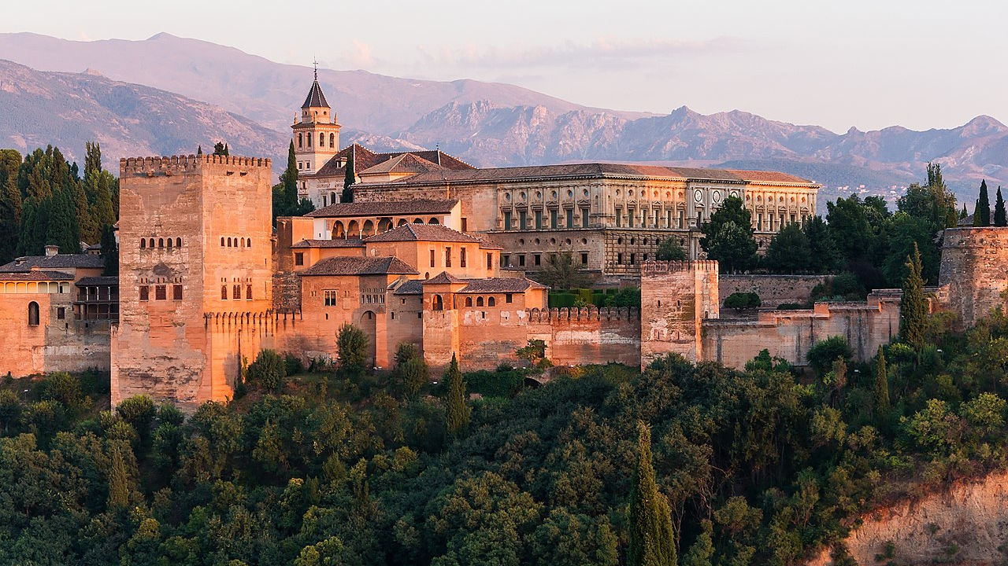
Granada
Andalucía
Last Moorish capital of Al Andalus(Nasrid dynasty) and last city to hold out the Reconquista(收复失地运动)
Arabic bath in Moorish bath houses
Moorish tea house to have tea
Moorish restaurant

Slide 22
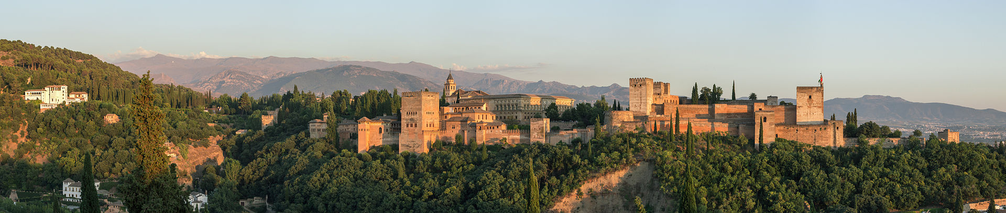
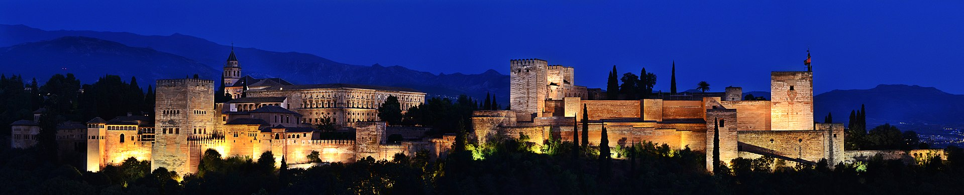
The Alhambra-Moorish Palace

Slide 23
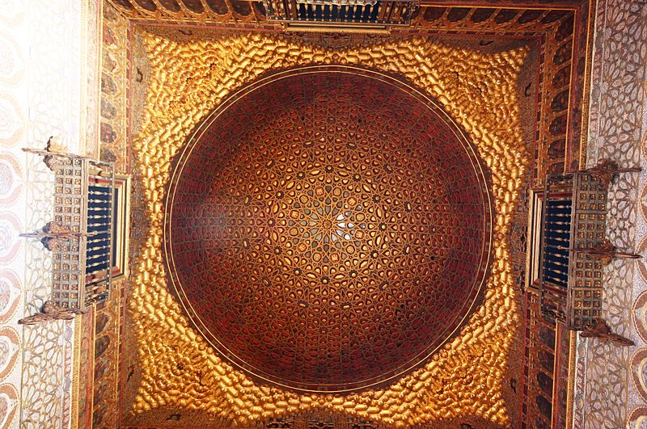
Hall of the Ambassadors
All about pattern and geometry
Contemplation and reflection
Bring people close to the God
Full of number seven and four
Seven: stages by which the soul ascend to God
Four: numbers of areas into which the vault of heaven could be divided
“There is no God but Allah. There is no conqueror but Allah”
Using water’s reflection, shifting and ephemeral to show the Islam’s tenet in architecture form that ”There is no God but God, there is no reality other than his higher reality. Everything people experienced in life is impermanent and insubstantial ”
https://evainmadrid.wordpress.com/2013/02/09/the-alhambras-hall-of-the-ambassadors/

Slide 24
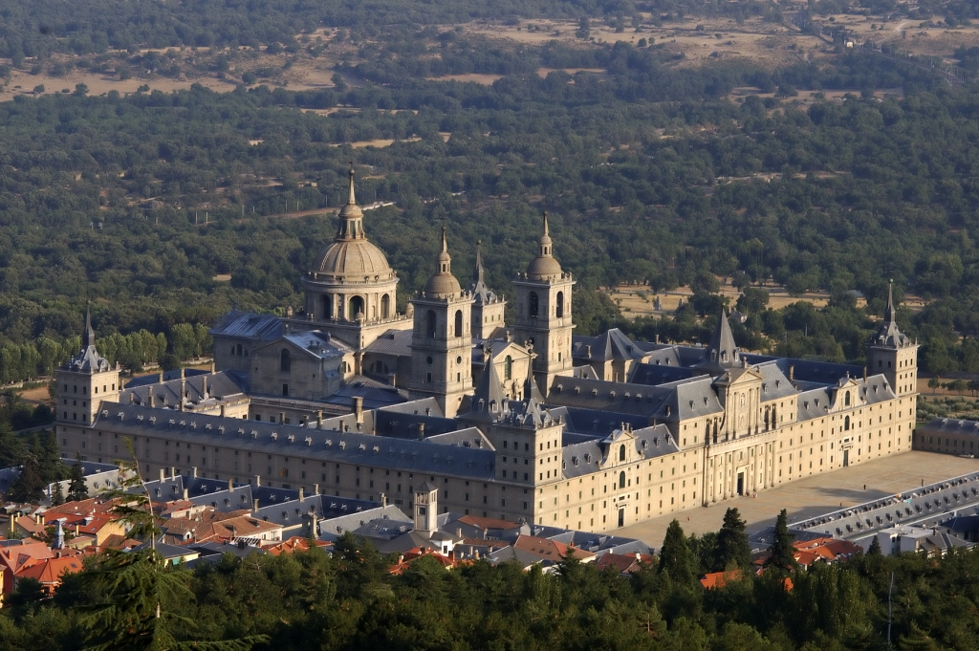
Royal Seat of San Lorenzo de El Escorial
Palace for Philip ②

Slide 25
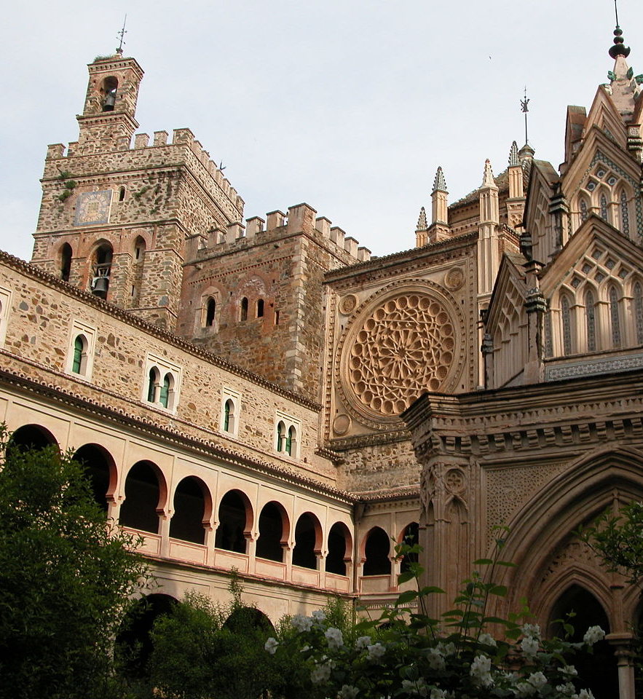
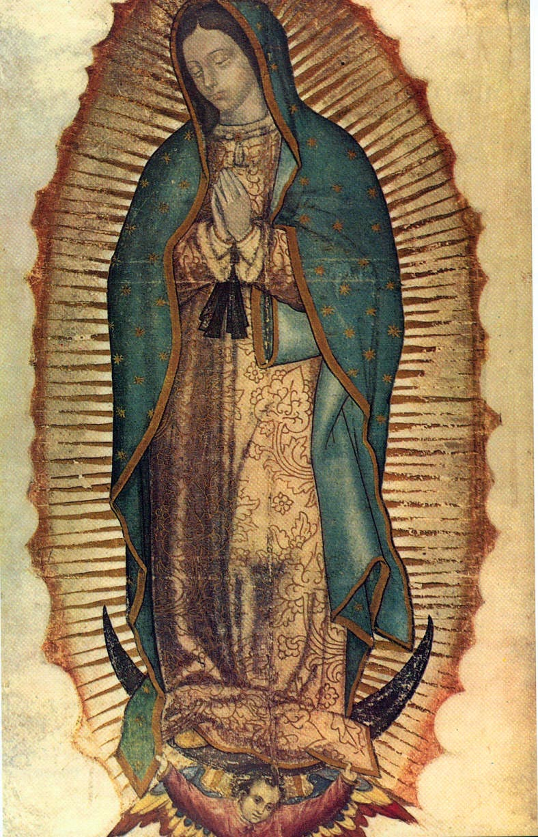
Extremadura Comunidad autónoma
Trujillo, Cáceres
Francisco Pizarro González: the Spanish conquistador who led an expedition that conquered the Inca Empire, Peru
The style of Renaissance
Monastery of Santa María de Guadalupe
Virgin of Guadalupe, Madonna of Guadalupe
May carved by St Luke

Slide 26
Salamanca Castilla y León
Spanish Inquisition, rigorous censorship
Plaza Mayor

Slide 27
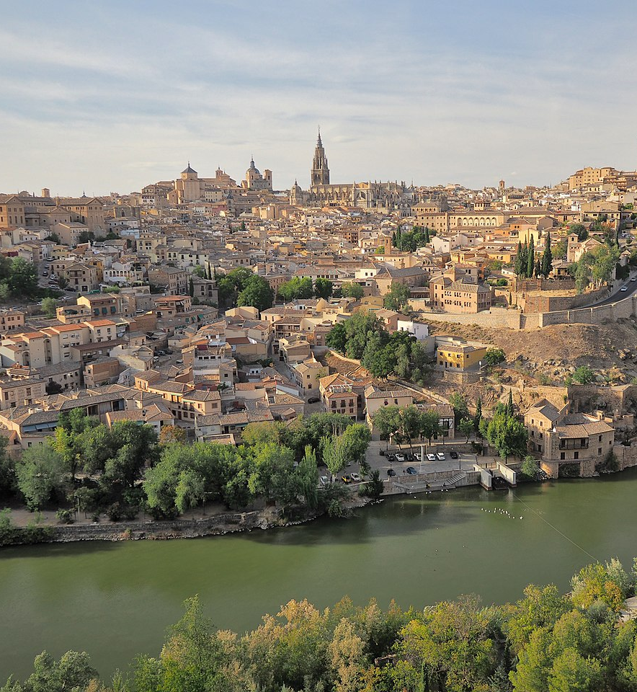
Toledo city Castilla La Mancha
Religious Center, center of La Mancha
Decorated like Roma, mystical spirit
Saint Pancrathio(Saint of health, money and work)
Saint Teresa(Saint of write and peace)
Saint Anthony(Saint of love for the single girls)
Notes:
https://read01.com/6mdnMN.html#.WxYXbUiFOUk

Slide 28
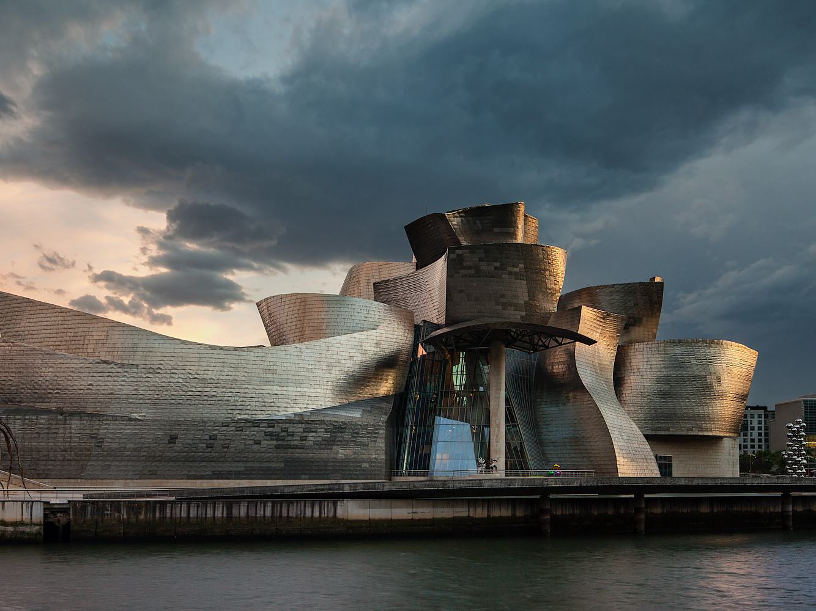
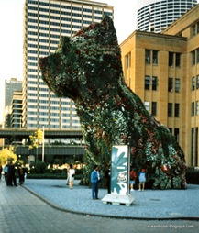
Bilbao
Frank Gehry’s Guggenheim
Jeff Koon flower-covered Puppy sculpture

Slide 29
Spanish
Muy Bueno: means very good
Lo siento: Sorry
Ave
Allegria: cheerfulness, fun
Las iglesias: The church

Slide 30
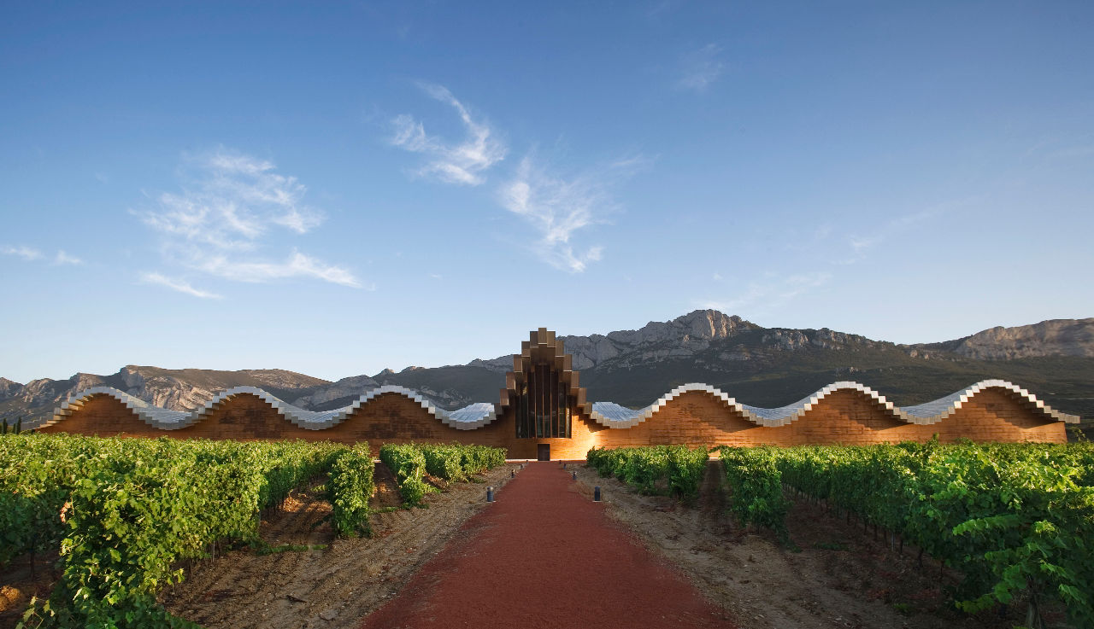
Rioja Region winery By Santiago calatrava

Slide 31
People
Artist
El Greco(1541-1614)
Francisco de Zurbarán(1598-1664)
Jusepe de Ribera(1591-1652)
Juan de Navarrete(1526-1579)
Antonio de Pereda(1611-1678)
Juan Sánchez Cotán(1560-1627)
Diego de Velazquez(1599-1660)
Francisco de Goya y Lucientes(1746-1828)
Antoni Gaudí(1852-1926)
Salvador Dali(1904-1989)
Henry Moore(1898-1986)
Pablo Picasso(1881-1973)
Joan Miró(1893-1983)
Luis Bunuel(1929–1977)
Abd Al-Rahman(731-788)
Creator of the Cordoba City
Pedro the Cruel(1334-1369)
The might of Abd al-Rahman
Caliph of AI-Andalus
Descendant of the great exile
Isabel I la Católica(1451-1504)
Queen of Castile
Saint Teresa of Avila(1515-1582)
Francisco Pizarro González(1471-1541)
Notes:
Nasrid Dynasty(1230-1492) is the last period of Taifas
Muhammad I of Granada
Force of Islam vs Force of Christianity

Slide 32
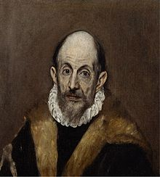
El Greco
El Greco(1541-1614)
Doménikos Theotokópoulos
Greek name: (Δομήνικος Θεοτοκόπουλος)
The Greek
Death of Saint Maurice
Pure Spirit Painting
Disrobing of Christ-Jesus about to be stripped before his crucifixion
Painting of Toledo
The burial of Court of Orgaz

Slide 33
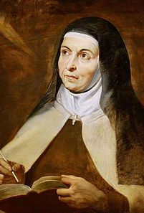
Teresa of Ávila
Saint Teresa of Avila(1515-1582)
Folk hero
“Life on earth, it’s no more than a night in a cheap hotel”
Saint Teresa drawing
Peter Paul Rubens(1557-1640)
Claudio Coello(1642-1693)
Convent of Alba de Tormes

Slide 34
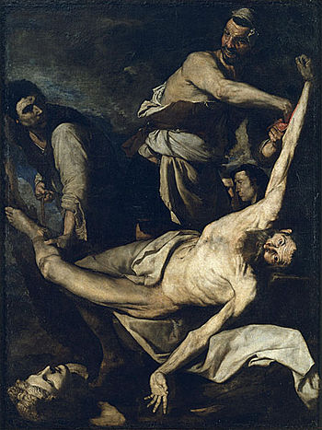
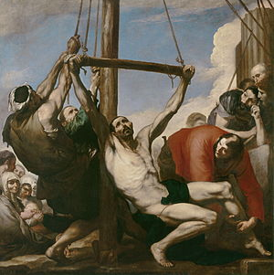
Jusepe de Ribera
Pain: Piety
God’s sigh written into your flesh, become one of his chosen
Speciality: martyrdoms with realism
Painting
The Martyrdom of Saint Philip
Martyrdom of Saint Bartholomew

Slide 35
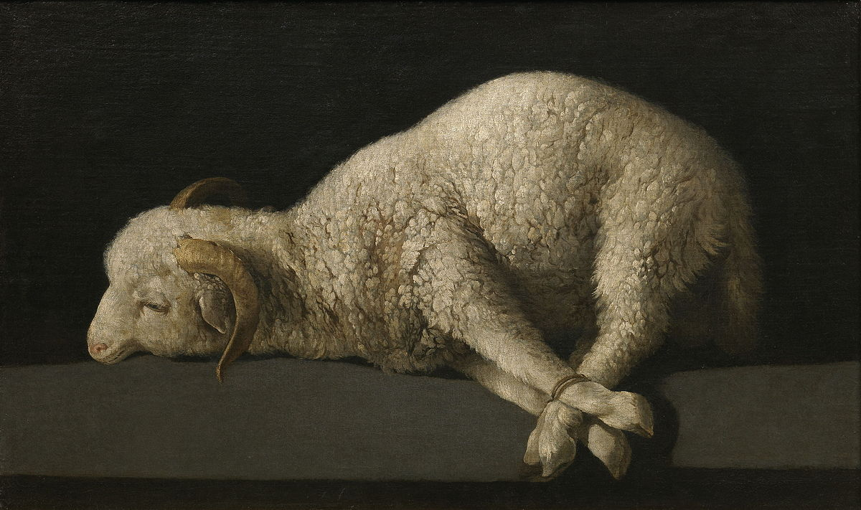
Francisco de Zurbarán
8 Pictures commemorating the ways spirit of Saint Jerome alive
The Jeronymite Order is inspired by Scholar and Saint Jerome
Jeronymite monks looked after Virgin

Slide 36
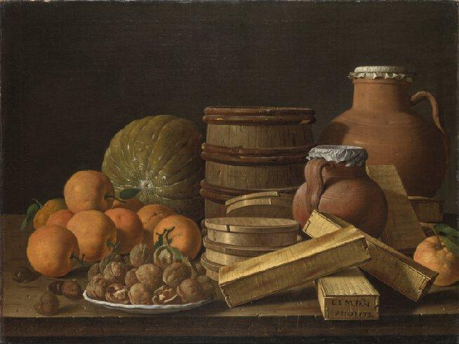
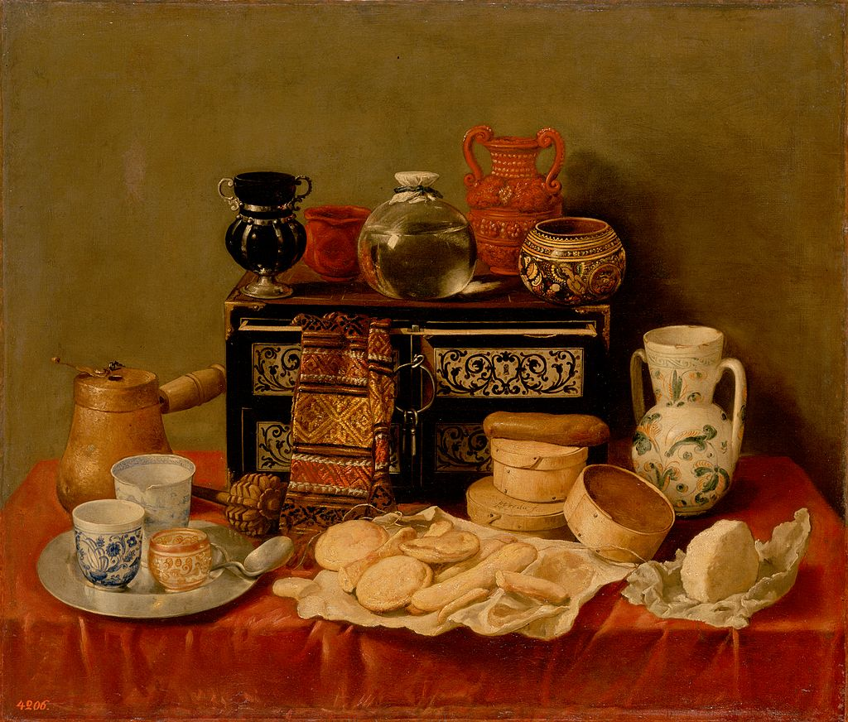
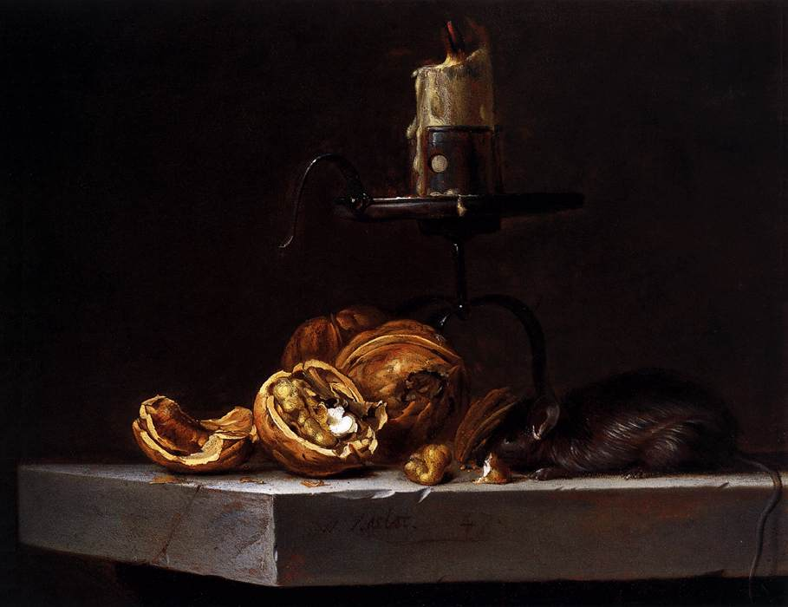
Antonio de Pereda

Slide 37
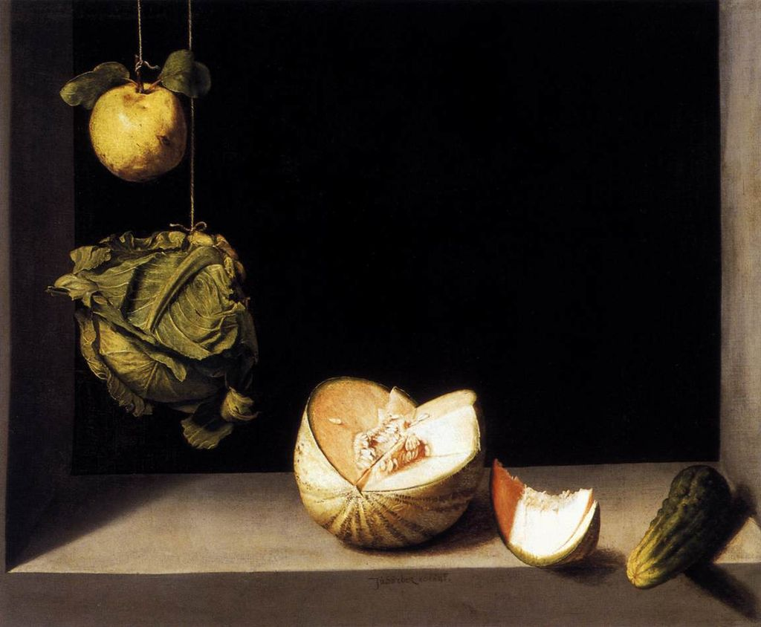
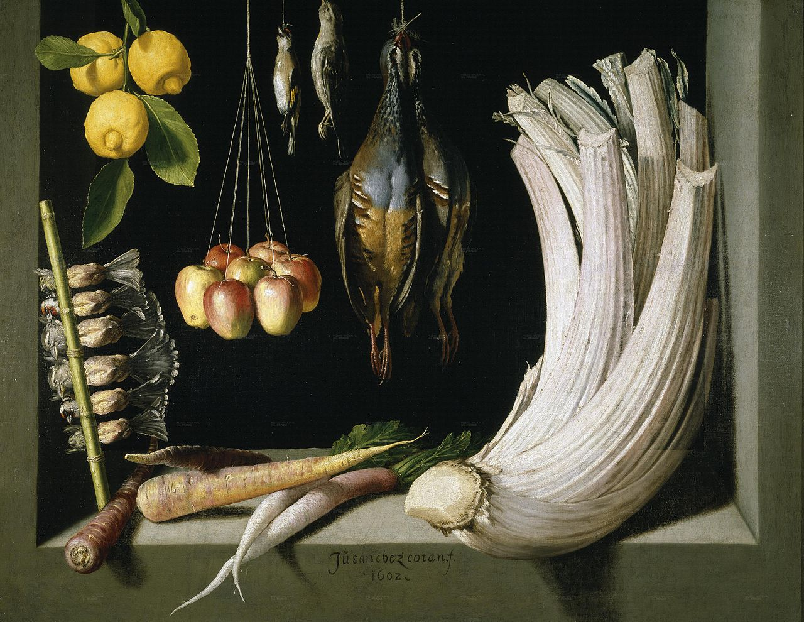
Juan Sánchez Cotán

Slide 38
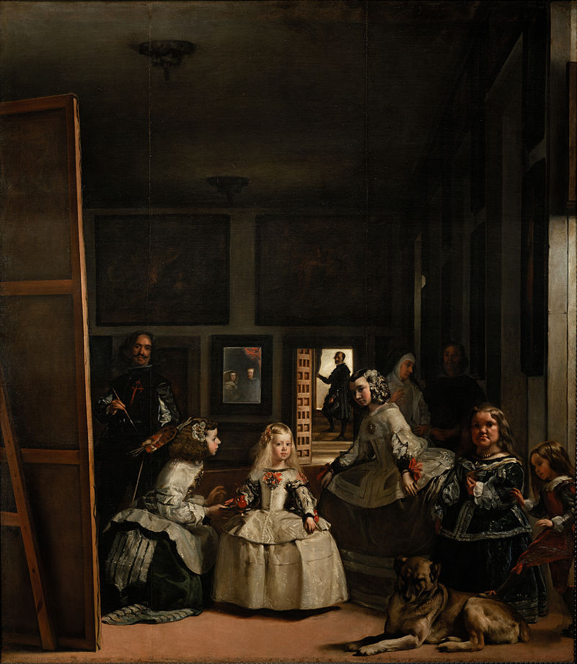
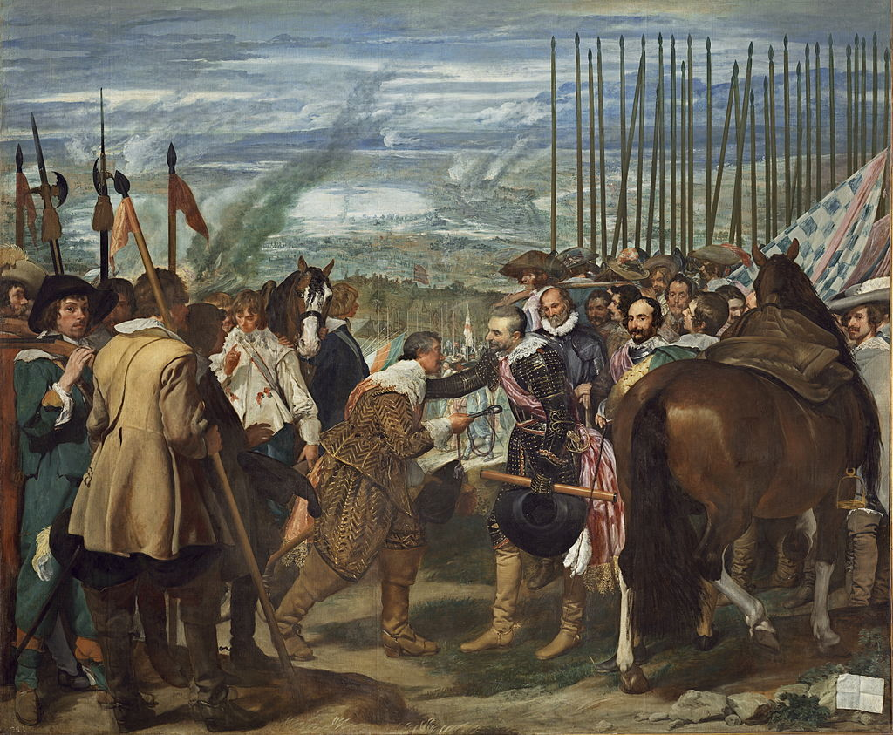
Diego de Velazquez
Notes:
Transience
Transitory

Slide 39
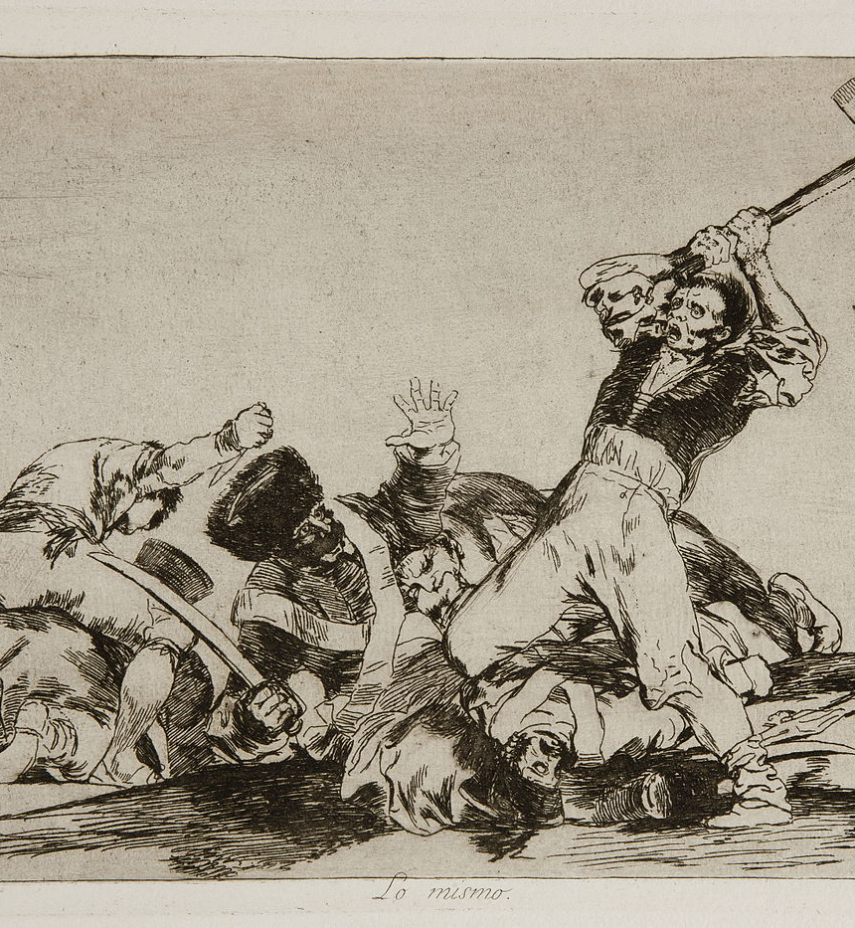
Francisco de Goya y Lucientes
Born in Aragon, Fuendetodos
Find the meaning of being a human being
Dark, Strange style
Deaf, Blind, Nightmarish, grotesque, pessimistic
Etching and Black Paintings
The Disasters of War
Notes:
Modern atheism vs Ancient religion

Slide 40
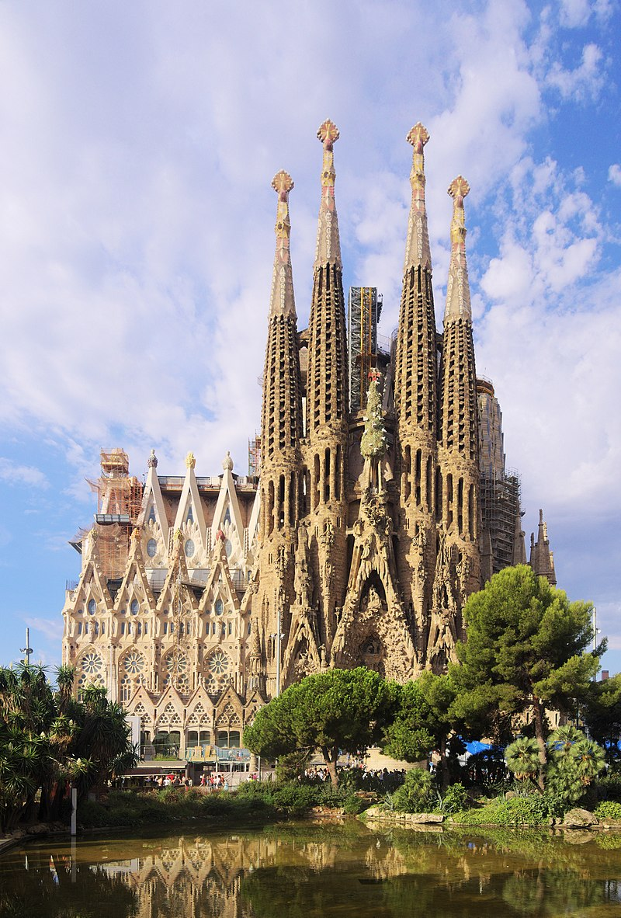

Antoni Gaudí
Parc Guell
Sagrada Familia
La Pedrera/ Stone Quarry
Notes:
Awe and wonder
Ceiling
10 Amazing Markets of Barcelona: https://www.citylifebarcelona.com/10-amazing-markets-of-barcelona/

Slide 41



Slide 42




Pablo Picasso
The First Communion
Cubism
Les Demoiselles D Avignon
Guernica
The Accordion Player

Slide 43



Joan Miró
Born At Montroig

Slide 44



Salvador Dali
The Persistence of Memory
The Spectre of Sex Appeal
Premonition of a Civil War

Slide 45


Luis Bunuel
Viridiana
Tristana

